Slide 1
Machine Learning
Table of Contents
01
Introduction
05
Model- HP-CNN
Using Machine Learning for Pedestrian Detection and Attribute Classification to Improve Road Safety
02
Project Summary
06
Image Classification
03
Model 1- YOLO v3
07
Model Comparison
04
Sample Code- YOLO v3
08
Conclusion and Recommendations
Made by Group 3

Slide 2
Table of Contents
01
02
03
04
Machine Learning
Machine Learning
Introduction
Using Machine Learning for Pedestrian Detection and Attribute Classification to Improve Road Safety
05
Model- HP-CNN
Project Summary
06
Image Classification
Model 1- YOLO v3
07
Model Comparison
Sample Code- YOLO v3
08
Conclusion and Recommendations

Slide 3
Introduction
01
Why This Project?
Pedestrian safety is a key challenge in smart transportation.
`
Machine learning can help detect people and predict their actions.

Slide 4
01
Introduction
Why This Project?
GOAL
Build smarter systems that recognize and understand pedestrians using images and videos.
Pedestrian safety is a key challenge in smart transportation.
`
Machine learning can help detect people and predict their actions.

Slide 5
Project Summary
01
Introduction
Why This Project?
GOAL
Build smarter systems that recognize and understand pedestrians using images and videos.
Pedestrian safety is a key challenge in smart transportation.
Machine learning can help detect people and predict their actions.
02

Slide 6
Project Summary
01
Introduction
The Project Focuses On
02
GOAL
Build smarter systems that recognize and understand pedestrians using images and videos.

Slide 7
Project Summary
The Project Focuses On
02
Detecting pedestrians in images and videos
Detecting pedestrians in images and videos
Recognizing their visual attributes (e.g., gender, bag).
Recognizing their visual attributes (e.g., gender, bag).
Using real-world datasets from surveillance cameras.
Using real-world datasets from surveillance cameras.

Slide 8
Project Summary
The Project Focuses On
02
03
Detecting pedestrians in images and videos
Model 1 – YOLOv3 for Pedestrian Detection
Recognizing their visual attributes (e.g., gender, bag).
Using real-world datasets from surveillance cameras.
Based on public data and models available online

Slide 9
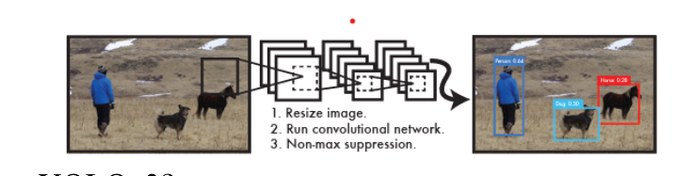
Model 1 – YOLOv3 for Pedestrian Detection
03
How it Works?
What is YOLOv3? A fast object detection model that finds people in images or videos in real-time.
What is YOLOv3? A fast object detection model that finds people in images or videos in real-time.
Function: Detects people in images/videos in real-time.
•⁠ ⁠How it works:
- Splits the image into grids.
- Predicts bounding boxes for people.
•⁠ ⁠Dataset: Public surveillance video (e.g., Milan station).

Slide 10
03
Model 1 – YOLOv3 for Pedestrian Detection
What is YOLOv3? A fast object detection model that finds people in images or videos in real-time.
Function: Detects people in images/videos in real-time.
•⁠ ⁠How it works:
• Splits the image into a grid.
• Each part looks for people and draws a box.
• Removes duplicate boxes.
• Gives fast results – perfect for live video.
Click here to see how it works [video]
04
How it Works?
Sample Code – YOLOv3
Function: Detects people in images/videos in real-time.
•⁠ ⁠How it works:
• Splits the image into a grid.
• Each part looks for people and draws a box.
• Removes duplicate boxes.
• Gives fast results – perfect for live video.

Slide 11
How it Works?
03
Model 1 – YOLOv3 for Pedestrian Detection
Function: Detects people in images/videos in real-time.
•⁠ ⁠How it works:
• Splits the image into a grid.
• Each part looks for people and draws a box.
• Removes duplicate boxes.
• Gives fast results – perfect for live video.
Click here to see how it works [video]
04
Why YOLOv3?
Real-time performance.
Accurate in crowded areas.
Easy to run with open-source code.
What is YOLOv3? A fast object detection model that finds people in images or videos in real-time.
Sample Code – YOLOv3

Slide 12
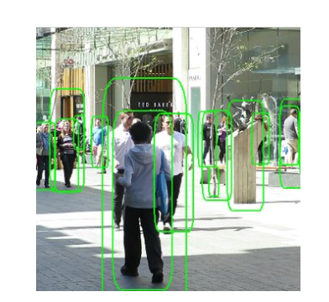
How it Works?
03
Model 1 – YOLOv3 for Pedestrian Detection
Dataset Used: MOT17
•Real video footage from streets and stations.
•560,000+ labeled boxes.
•Includes occlusion info.
To see the structure of the data click here
Why YOLOv3?
Real-time performance.
Accurate in crowded areas.
Easy to run with open-source code.
Function: Detects people in images/videos in real-time.
•⁠ ⁠How it works:
• Splits the image into a grid.
• Each part looks for people and draws a box.
• Removes duplicate boxes.
• Gives fast results – perfect for live video.
Click here to see how it works [video]
Dataset Used: MOT17
•Real video footage from streets and stations.
•560,000+ labeled boxes.
•Includes occlusion info.
04
Sample Code – YOLOv3

Slide 13
How it Works?
03
Model 1 – YOLOv3 for Pedestrian Detection
Dataset Used: MOT17
•Real video footage from streets and stations.
•560,000+ labeled boxes.
•Includes occlusion info.
To see the structure of the data click here
Why YOLOv3?
Real-time performance.
Accurate in crowded areas.
Easy to run with open-source code.
Function: Detects people in images/videos in real-time.
•⁠ ⁠How it works:
• Splits the image into a grid.
• Each part looks for people and draws a box.
• Removes duplicate boxes.
• Gives fast results – perfect for live video.
04
Sample Code – YOLOv3

Slide 14
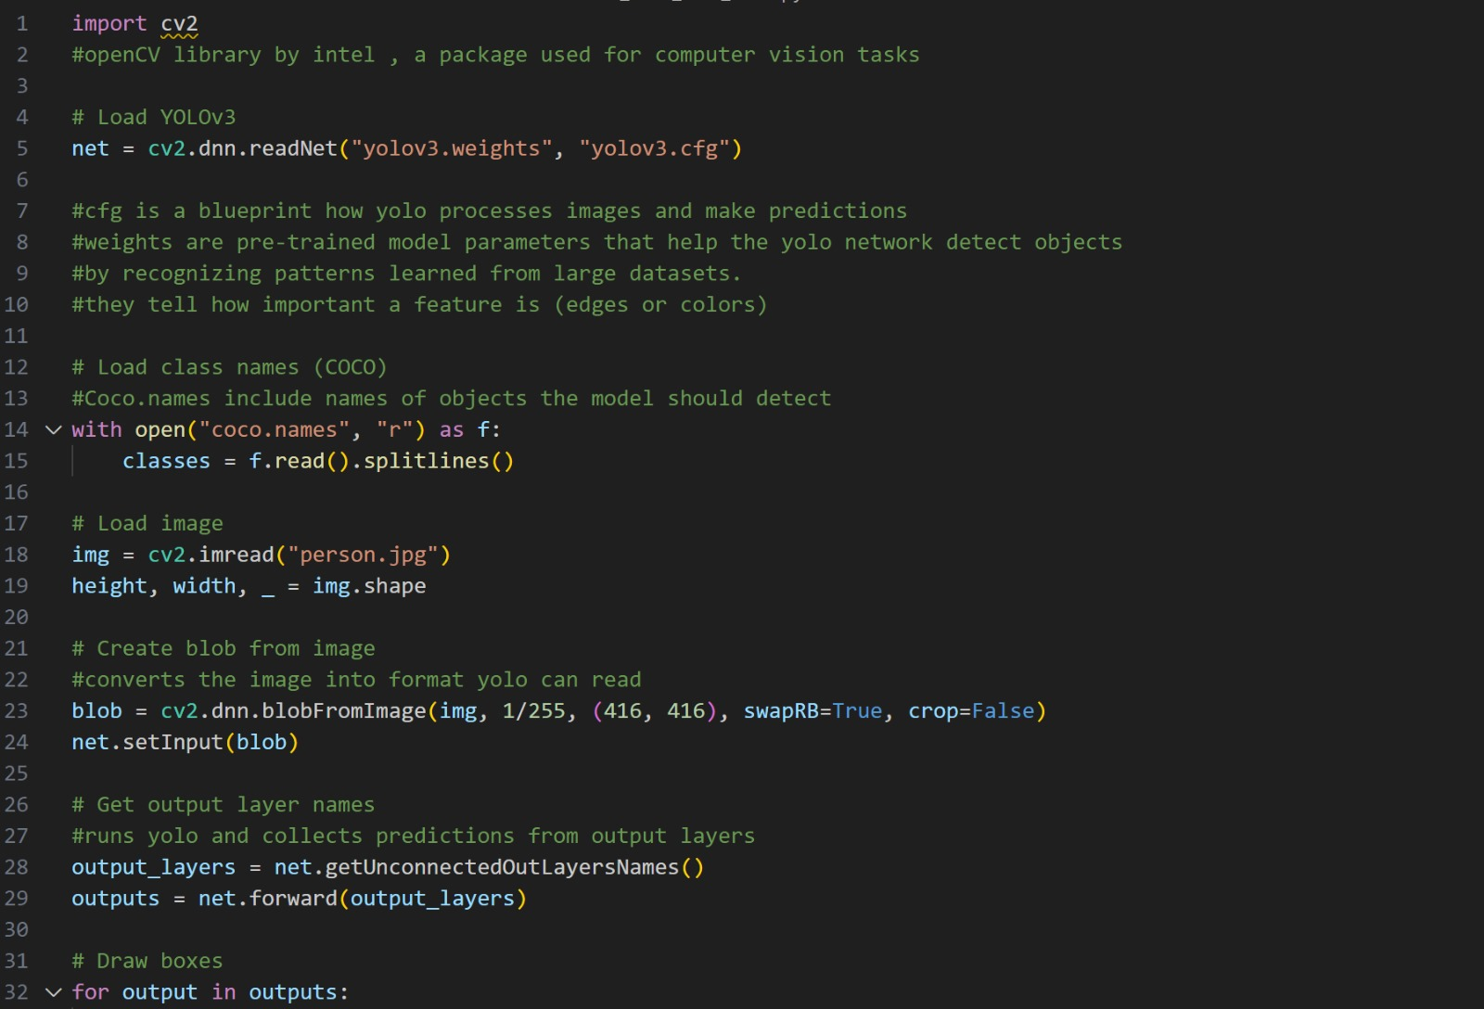
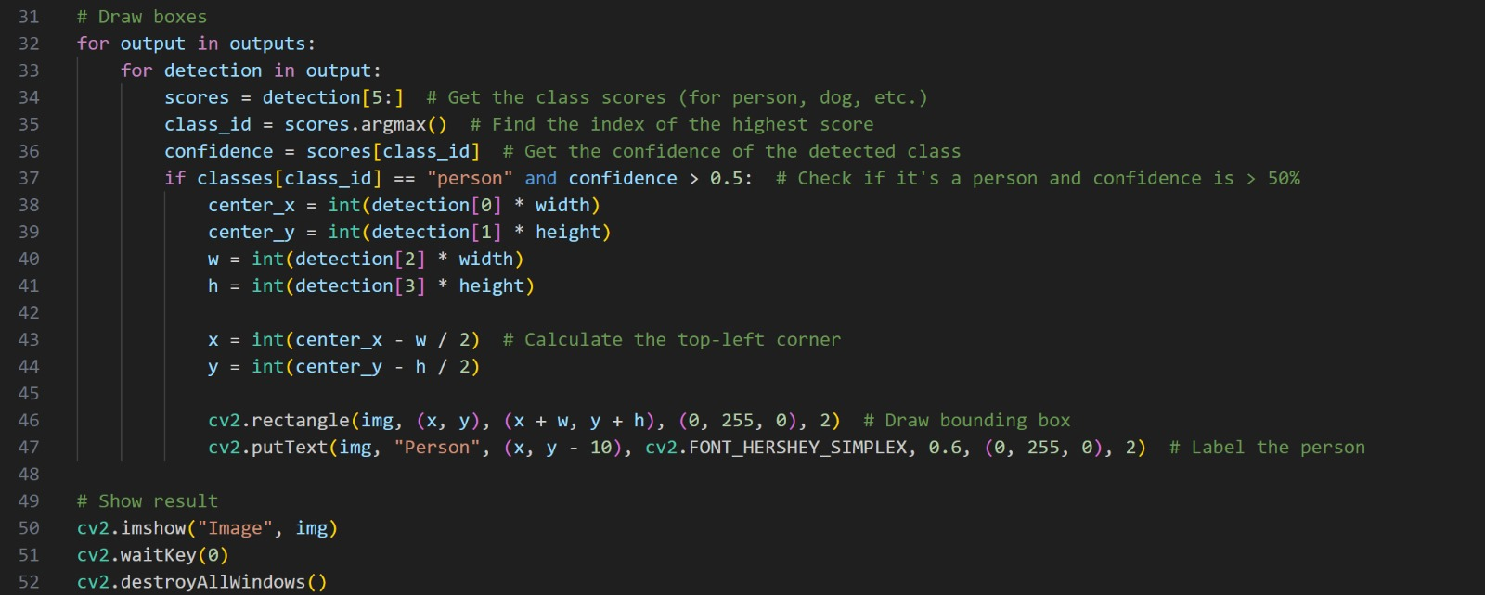
Sample Code – YOLOv3
03
Model 1 – YOLOv3 for Pedestrian Detection
How it Works?
Dataset Used: MOT17
•Real video footage from streets and stations.
•560,000+ labeled boxes.
•Includes occlusion info.
To see the structure of the data click here
#Process image to detect people... - Shows how to load and use YOLOv3 with OpenCV. - Simple use-case: detect people in one image.
Function: Detects people in images/videos in real-time.
•⁠ ⁠How it works:
- Splits the image into grids.
- Predicts bounding boxes for people.
•⁠ ⁠Dataset: Public surveillance video (e.g., Milan station).
04
Sample Code – YOLOv3
net = cv2.dnn.readNet("yolov3.weights", "yolov3.cfg")
img = cv2.imread("people.jpg")
# Process image to detect people...
- Shows how to load and use YOLOv3 with OpenCV.
- Simple use-case: detect people in one image.

Slide 15
Sample Code – YOLOv3
04
#Process image to detect people... - Shows how to load and use YOLOv3 with OpenCV. - Simple use-case: detect people in one image.
05
Model 2 – HP-CNN for Attribute Recognition

Slide 16
Model 2 – HP-CNN for Attribute Recognition
04
Sample Code – YOLOv3
Sample Code – YOLOv3
#Process image to detect people... - Shows how to load and use YOLOv3 with OpenCV. - Simple use-case: detect people in one image.
05
What is HP-CNN?
A deep learning model that detects multiple attributes of a person from one image.
What it predicts:
• Gender (Male / Female)
• Accessories (e.g. Backpack, Hat)
• Clothing Style (e.g. Long sleeves, Shorts)

Slide 17
Model 2 – HP-CNN for Attribute Recognition
05
What is HP-CNN?
How it works:
1. Takes an image of a pedestrian
2. Extracts visual features
3. Focuses on important body parts
4. Predicts several attributes at the same time
A deep learning model that detects multiple attributes of a person from one image.
What it predicts:
• Gender (Male / Female)
• Accessories (e.g. Backpack, Hat)
• Clothing Style (e.g. Long sleeves, Shorts)
How it works:
1. Takes an image of a pedestrian
2. Extracts visual features
3. Focuses on important body parts
4. Predicts several attributes at the same time
Click here to see how it works [video]

Slide 18
Model 2 – HP-CNN for Attribute Recognition
05
What is HP-CNN?
Dataset Used:
RAP Dataset – 41,000+ labeled images from surveillance cameras.
Right side (Visuals):
• One image showing a person with labeled attributes (e.g., “Male”, “Backpack”, “Wearing Cap”)
• Optional: flowchart or 3 steps: Image → Features → Attributes
How it works:
1. Takes an image of a pedestrian
2. Extracts visual features
3. Focuses on important body parts
4. Predicts several attributes at the same time
Click here to see how it works [video]
A deep learning model that detects multiple attributes of a person from one image.
What it predicts:
• Gender (Male / Female)
• Accessories (e.g. Backpack, Hat)
• Clothing Style (e.g. Long sleeves, Shorts)
Dataset Used:
RAP Dataset – 41,000+ labeled images from surveillance cameras.
Right side (Visuals):
• One image showing a person with labeled attributes (e.g., “Male”, “Backpack”, “Wearing Cap”)
• Optional: flowchart or 3 steps: Image → Features → Attributes
To see the structure of the data click here

Slide 19
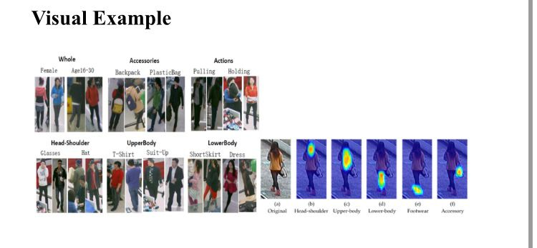
Model 2 – HP-CNN for Attribute Recognition
05
What is HP-CNN?
Dataset Used:
RAP Dataset – 41,000+ labeled images from surveillance cameras.
Right side (Visuals):
• One image showing a person with labeled attributes (e.g., “Male”, “Backpack”, “Wearing Cap”)
• Optional: flowchart or 3 steps: Image → Features → Attributes
To see the structure of the data click here
How it works:
1. Takes an image of a pedestrian
2. Extracts visual features
3. Focuses on important body parts
4. Predicts several attributes at the same time
Click here to see how it works [video]
How it works:
1. Takes an image of a pedestrian
2. Extracts visual features
3. Focuses on important body parts
4. Predicts several attributes at the same time
A deep learning model that detects multiple attributes of a person from one image.
What it predicts:
• Gender (Male / Female)
• Accessories (e.g. Backpack, Hat)
• Clothing Style (e.g. Long sleeves, Shorts)

Slide 20
Model 2 – HP-CNN for Attribute Recognition
05
Dataset Used:
RAP Dataset – 41,000+ labeled images from surveillance cameras.
Right side (Visuals):
• One image showing a person with labeled attributes (e.g., “Male”, “Backpack”, “Wearing Cap”)
• Optional: flowchart or 3 steps: Image → Features → Attributes
What is HP-CNN?
How it works:
1. Takes an image of a pedestrian
2. Extracts visual features
3. Focuses on important body parts
4. Predicts several attributes at the same time
A deep learning model that detects multiple attributes of a person from one image.
What it predicts:
• Gender (Male / Female)
• Accessories (e.g. Backpack, Hat)
• Clothing Style (e.g. Long sleeves, Shorts)
Dataset Used:
RAP Dataset – 41,000+ labeled images from surveillance cameras.
Right side (Visuals):
• One image showing a person with labeled attributes (e.g., “Male”, “Backpack”, “Wearing Cap”)
• Optional: flowchart or 3 steps: Image → Features → Attributes
To see the structure of the data click here

Slide 21
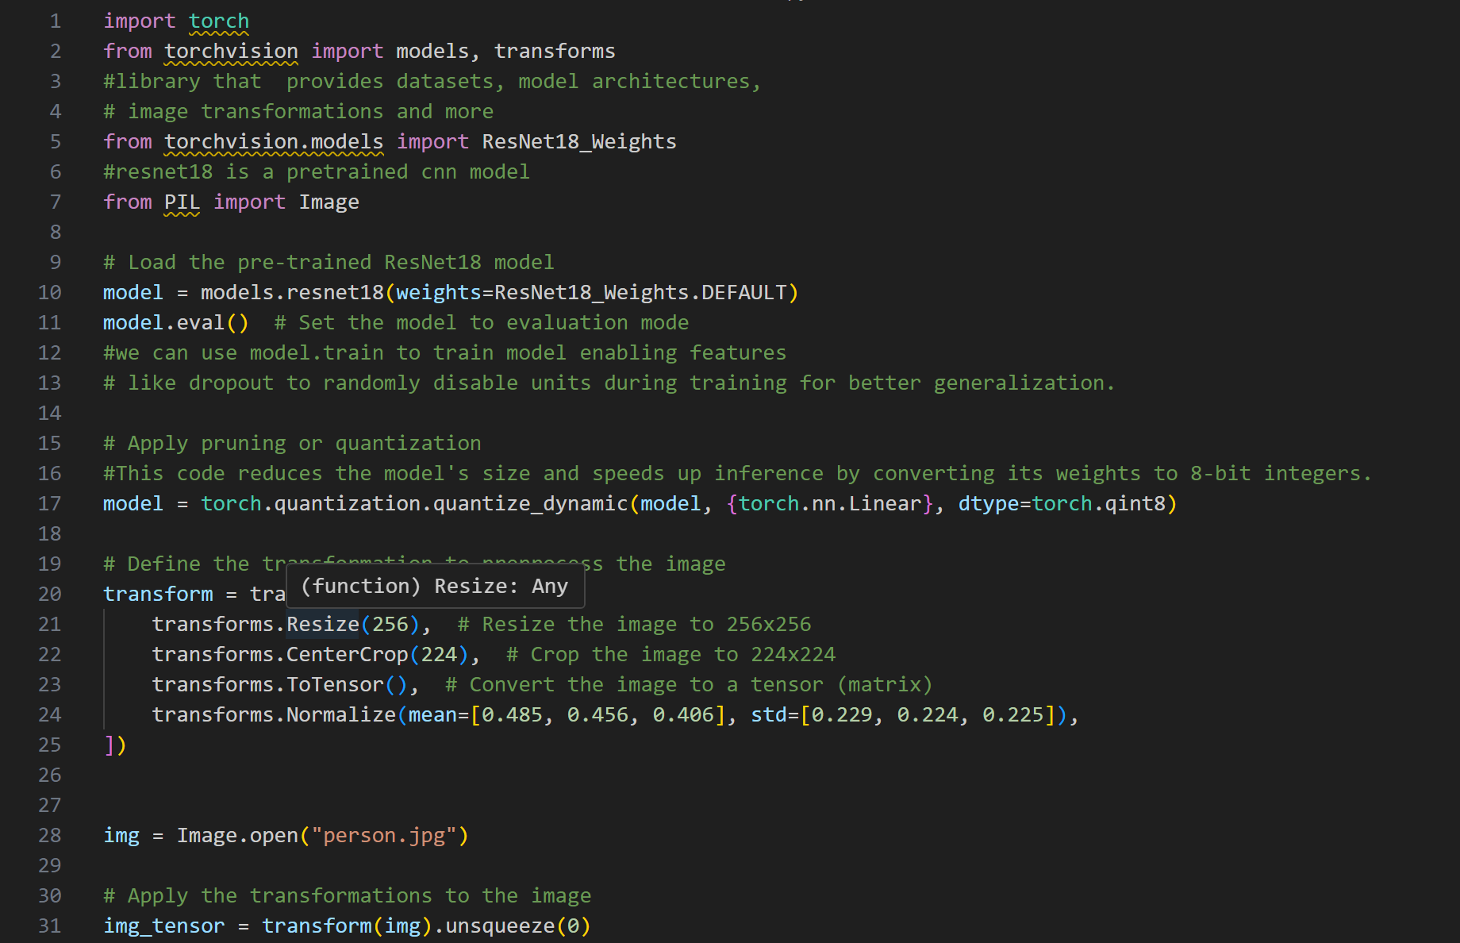
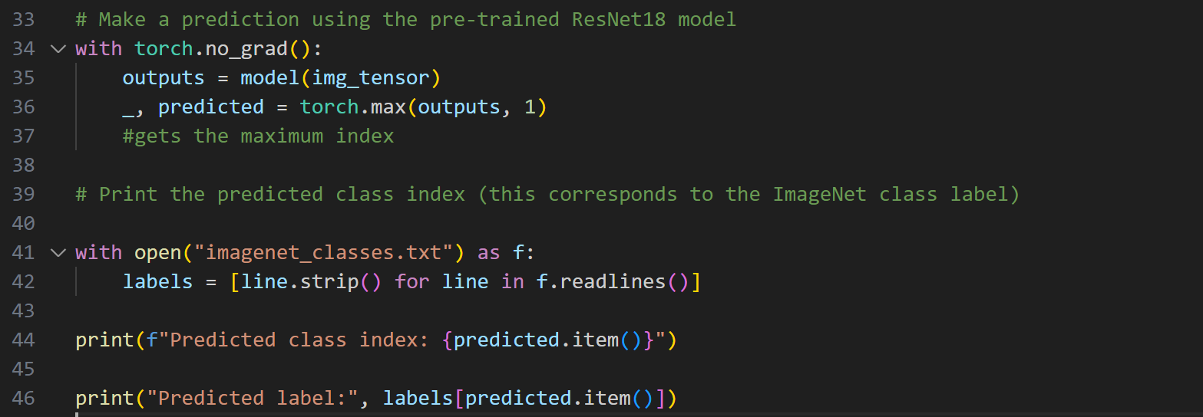
Sample Code – Image Classification
06
•⁠ ⁠Example of how a trained CNN can classify a person’s image.
•⁠ ⁠Simulates HP-CNN’s behavior (simplified version).

Slide 22
Sample Code – Image Classification
06
•⁠ ⁠Example of how a trained CNN can classify a person’s image.
•⁠ ⁠Simulates HP-CNN’s behavior (simplified version).
07
Comparison Between Models

Slide 23
Comparison Between Models
06
Sample Code – Image Classification
•⁠ ⁠Example of how a trained CNN can classify a person’s image.
•⁠ ⁠Simulates HP-CNN’s behavior (simplified version).
07
Model | Purpose | Strength | Limitation
YOLOv3 | Pedestrian Detection | Fast real-time | Struggles in crowded scenes
HP-CNN | Attribute Recognition | High accuracy | Requires clear image data

Slide 24
Conclusion & Recommendations
07
Comparison Between Models
Model | Purpose | Strength | Limitation
YOLOv3 | Pedestrian Detection | Fast real-time | Struggles in crowded scenes
HP-CNN | Attribute Recognition | High accuracy | Requires clear image data
08

Slide 25
Conclusion & Recommendations
Model | Purpose | Strength | Limitation
YOLOv3 | Pedestrian Detection | Fast real-time | Struggles in crowded scenes
HP-CNN | Attribute Recognition | High accuracy | Requires clear image data
07
Comparison Between Models
08
ML models like YOLOv3 and HP-CNN are powerful tools for road safety.
•⁠ ⁠Public datasets (e.g., RAP) make it easier to build and test models.
•⁠ ⁠Simple code implementations show how these systems work in real life.
•⁠ ⁠These models can be used in smart cars, surveillance, and traffic systems.

Slide 26
08
Conclusion & Recommendations
ML models like YOLOv3 and HP-CNN are powerful tools for road safety.
•⁠ ⁠Public datasets (e.g., RAP) make it easier to build and test models.
•⁠ ⁠Simple code implementations show how these systems work in real life.
•⁠ ⁠These models can be used in smart cars, surveillance, and traffic systems.

